Slide 1

Food Commodity Budgeting using Inflation Rate Forecasting
Lydia Swatek
Regis University
MSDS 692: Data Science Practicum 1
June 26th, 2022

Slide 2
Project Overview
Background
Problem Statement
Data Overview
Exploratory Data Analysis
Machine Learning Techniques
Analysis
Findings
Future Steps

Slide 3
Background
Most companies set an annual budget at the beginning of each year
The primary disruptor to an organization’s budget is inflation.
Typically inflation rates hover around 2%
Inflation has risen 7.9% in the last 12 months
Notes:
COVID, Supply Chain Issues and the war in the Ukraine

Slide 4
Problem Statement
Problem
Due to the high level of volatility in the market, especially for food, it is imperative that organizations have more agility and accuracy in when they conduct their budget forecasting each year.
Solution
If organization were able to utilize market basket CPIs to forecast all of their budgets and not have to forecast for food with a separate CPI, they could more quickly adjust for inflation across the board.
Impact
This would allow them to reforecast more often, quickly adjust spend based off of inflation, and be more agile with their budgets.

Slide 5
Data Overview
Consumer Price Index
Food Consumer Price Index
Historical Grocery Spend
National 2021 CPI
Goods and Services Market Basket
1 Food and Beverage CPI
2 Food and Beverage CPI
3 Food and Beverage CPI
1 Historical Food Spend
2 Historical Food Spend

Slide 6
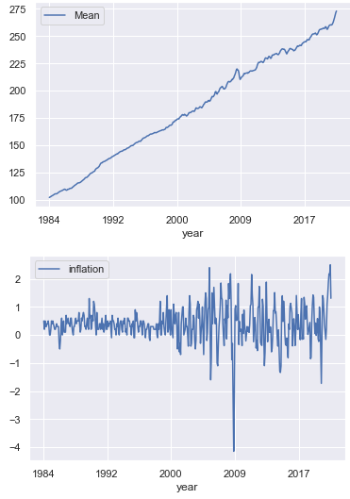
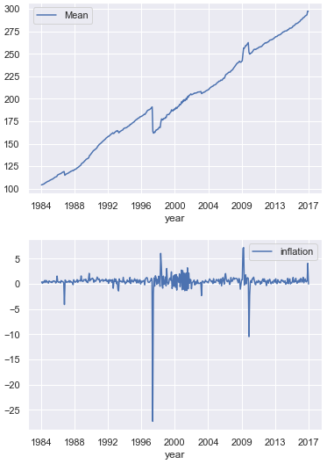
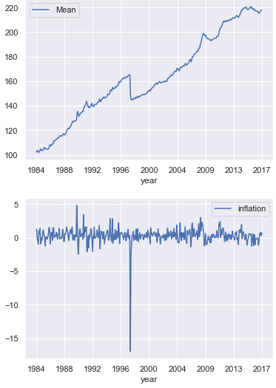
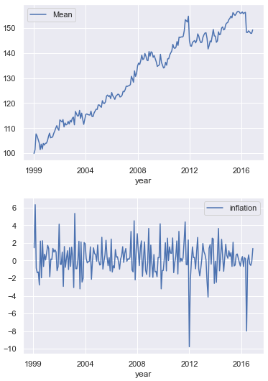
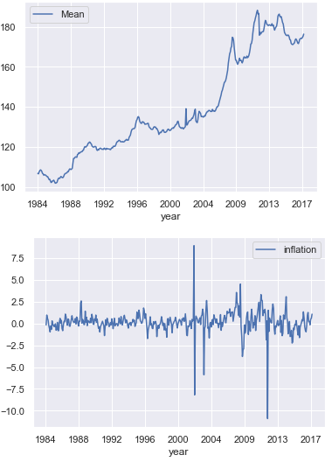
Exploratory Data Analysis
The datasets were analyzed by looking at the breakdown of the data mathematically and visually.
The goal of this EDA was to see if the datasets had similar trends or had a close enough correlation to use.
National 2021 CPI
Market Basket CPI
1 Food CPI
2 Food CPI
3 Food CPI

Slide 7
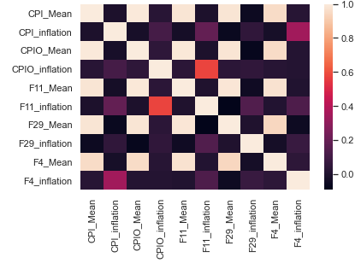
EDA (cont)
Once the previous graphs were analyzed, it appeared the Market Basket CPI data and the 1st Food and Beverage datasets had the strongest correlation.
To further verify this a heat map was generated which confirmed this correlation.
This correlation lead to using the Market Basket CPI dataset for the machine learning modules.

Slide 8
Machine Learning Techniques
7 Machine Learning techniques were tested
KNN
Linear Regression
ARIMA
LASSO
EN
CART
SVR
The data from 3 of the models were used to forecast food and beverage prices.
KNN
Linear Regression
ARIMA

Slide 9
Machine Learning Techniques
KNN Model
Two KNN Model were preformed: one with the date column split apart and one with it combined
Had the strongest Mean Squared Error (MSE) score
Created predictive data based off of the Market Basket CPI dataset
Linear Regression Model
Had the second strongest MSE score
Created predictive data based off of the Market Basket CPI dataset
ARIMA Model
Widely used for demand forecasting
Created predictive data based off of the 1st Food and Beverage CPI dataset
The forecast was a constant value, which shows that while food and beverage prices might fluctuate heavily month over month, they still increase at a relatively constant rate

Slide 10
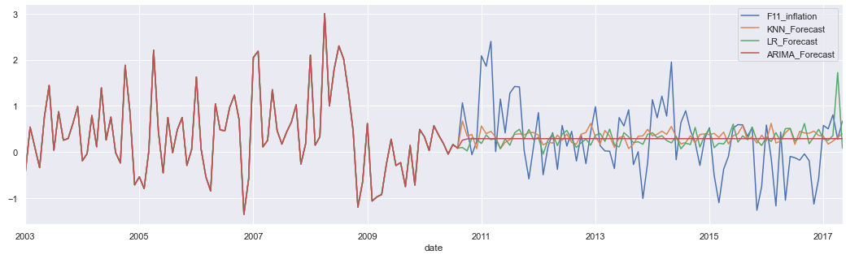
Analysis
The 3 inflation rate predictions were compared to the 1st Food and Beverage data.
While there is fluctuation in two of the models, all three models have inflation rates that hover around 0.29%.

Slide 11
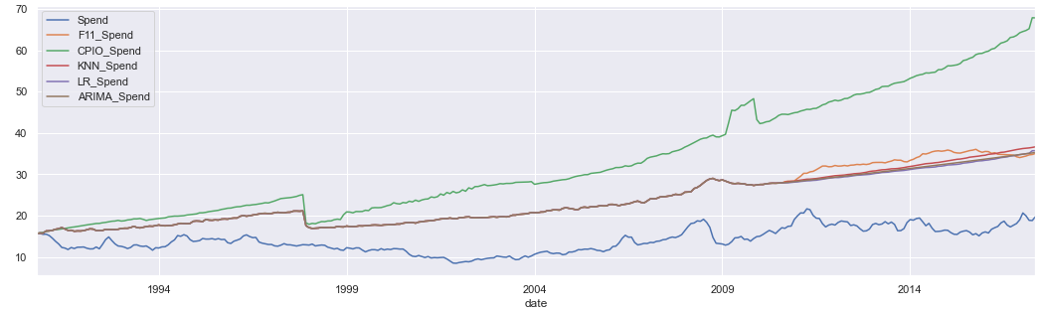
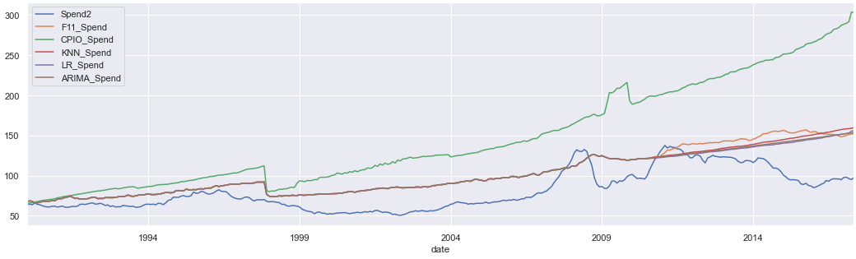
Analysis
The 3 inflation rate predictions were used to calculate the price of food and beverage spend for both Food and Beverage datasets
The predicted prices were then compared to the actual Food and Beverage prices in the datasets.
1st Historic Food and Beverage Data Comparison
2nd Historic Food and Beverage Data Comparison

Slide 12
Findings
All three models over estimated Food and Beverage prices for both datasets
The price between the models and the 1st Food and Beverage dataset was on average $5-$10 more expense than the actuals
The price between the models and the 2nd Food and Beverage dataset fluctuated back and forth more, but as time went on the models estimated costs $50 higher than the actuals
The Consumer Price Index can estimate market trends on a large scale, however for individual, smaller dataset the CPI has shown to over estimate food and beverage prices
Food and Beverage prices don’t increase as quickly as expected
Other CPIs can be used to train a food and beverage model, this can be seen because the models are inline with the 1st Food and Beverage price calculation.

Slide 13
Future Steps
A better identifier for companies to use to budget would be to analyze how their own spend has fluctuated over time and use that to train the models.
All three models are useful to help predict prices
Overall spend inflation rates appear to be good predictors of food and beverage spend, however this needs to be tested at the individual organizations level, instead of using nation numbers.

